Slide 1
Introduction à la préservation numérique
Sarah Lake
Bibliothécaire responsable de la préservation numérique
Université Concordia
sarah.lake@concordia.ca
BiblioTECH 2023
Notes:
Introduce myself and introduce the session:
The goal for today is really just to give you an introductory-level understanding of the practice of digital perservation, in the hopes that if you're curious about this field, or even if you've never heard anything about it, maybe you can keep it in mind as a possible interesting career path.
I'm go over some fundamental concepts and demonstrate the application of these concepts using a few open-source tools; and we'll have some time at the end for questions—but also feel free to ask questions throughout in the chat, I'll try to keep an eye on it

Slide 2
Plan de la présentation
Qu’est-ce que la préservation numérique?
Préservation des bits
Fixité
Duplication
D’autres stratégies de préservation numérique
Identification, description et validation des formats de fichiers
Migration, standardisation et émulation des fichiers
Infrastructure de préservation numérique
Démonstration d’Archivematica

Slide 3
Qu’est-ce que la préservation numérique?
La préservation numérique désigne l’ensemble des pratiques de gestion qui visent à garantir l’accès continu à un bien numérique.
Digital Preservation Coalition
Notes:
This is a good place to start, I think. I like this definition because it really accurately frames digital preservation as an ongoing process, and something that requires a sustained commitment.

Slide 4
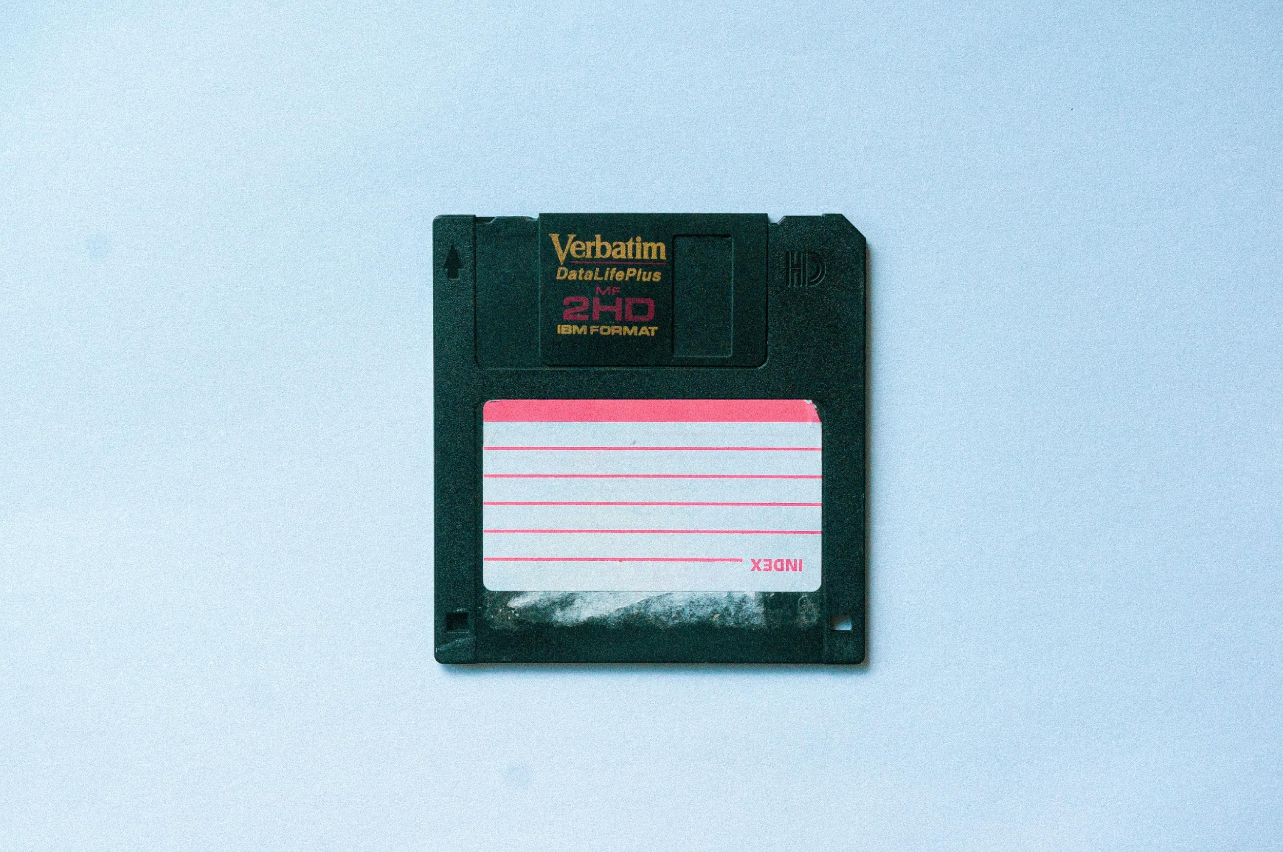
Pourquoi la préservation numérique est-elle nécessaire?
L’accès à un bien numérique peut être compromis par:
Corruption de fichier
Bris de support
Erreur humaine
Obsolescence et transformation des technologies
Notes:
why is this necessary? the nature of digital material makes preserving them quite challenging for various;
files get corrupted, hard drives fail, these are really common realities that often lead to the loss of digital materials
Digital files are also really easy to modify or delete: most of us here have probably experienced this
obsolescence and technological change is a big one; the nature of digital materials is such that our interaction with them is always mediated through several layers of technology: to open a file and see what's inside it, you need hardware—a computer, but you also need an operating system, and you also need that specific piece of software that can read the file. And all of these things, the computer, OS and software change really quickly, and can become obsolete inn just a few years. So it's actually a real challenge to keep digital content usable over a long period of time.
An easy example to illustrate the importance of digital preservation is if you think of something that's written on paper, if it’s stored properly in acid-free folders and controlled climate, can last for centuries without any intervention needed—but if you tried to open a word processing file that no one had touched in just 20 years, there's high chances that that content would be irretreivable.

Slide 5
Préservation des bits
Notes:
I'm going to go over the most basic ways that digital archivists mitigate the risks that I mentioned, which is also referred to as bit level preservation:

Slide 6
Préservation des bits
Préserver une copie d’un bien numérique, sans nécessairement veiller à ce qu’on puisse continuer à l’utiliser.
2 stratégies principales: fixité et duplication
Notes:
When we're talking about bit-level preservation, we're talking about the most basic form of digital preservation
Bit-level preservation means preserving the bitstream of a digital file—at the most fundamental level, digital files are composed of series of 1s and 0s, also called a bitstream.
The goal of bit-level preservation is preserving the bitstream, making sure those 1s and 0s are safe, but you're not necessarily preserving the ability to meaningfully render and use the data
ex of word processing file from the 90s
I know it's a kind of abstract concept right now, but it will make a bit more sense later on when we talk about more advanced digital preservation strategies that go beyond bit-level preservation
I'll be talking about two main strategies

Slide 7
Fixité
La fixité (ou l’intégrité) d’un fichier indique s’il est resté inchangé à travers le temps. Calculer la somme de contrôle (checksum) d’un fichier permet de vérifier sa fixité.
Exercice : utilisez la commande md5 pour calculer la somme de contrôle d’un fichier
Notes:
There two main strategies that we can use to support bit-level preservation: the first one is fixity (also sometimes referred to as integrity)
Fixity is the assurance that a digital file has remained unchanged over time. By monitoring fixity, we can be sure that files in our care haven't been modified or corrupted.
The main tool that digital archivists use to monitor fixity is checksums.
A checksum is an alphanumeric string that's created by an algorithm and unique to each file. You can think of it as a ‘digital fingerprint’ whereby even the smallest change to the file will cause the checksum to change completely.
Standard practice is to calculate checksums whenever files are moved, so for example at the moment that a donor transfers a set of files to the repository. It's also good practice to do regular fixity checks on the files in your repository, to ensure that none of them have been corrupted or modified—and so that if they have, you can replace a corrupted copy with a clean one.
demo
Of course that example is totally manual: checksums in practice are almost never calculated like that—there's scripts and programs that will automatically calculate checksusm for vast nubmers of files and then comapre those values to the previously calculated value to make sure they match.
Any questions about fixity?

Slide 8
Duplication
Sauvegarder des copies d’un bien numérique à plusieurs emplacements et sur des supports différents réduit les risques de le perdre. Les fichiers de ces copies devraient être indépendants les uns des autres afin d’éviter leur suppression accidentelle.
Voir les directives de la NDSA sur la préservation numérique : https://ndsa.org/publications/levels-of-digital-preservation/.
Notes:
Another basic way to ensure bit-level preservation is through replication: one advantage of digital files in terms of preservation is that it's really easy to create a large amount of exact copies of them, and we all know that lots of copies keeps stuff safe.
A key component to preserving digital materials is having several copies in different geographic locations and on different types of storage media
An example of this: different repositories across canada have agreements to host copies of each others' data; so that if there's a natural disaster in one province, the copies in the other provinces will be safe; so that's why geographic spread Is ideal
Types of storage: again, this just mitigates the risk of losing data in the event of a disaster; one on local networked drives, one in cloud storage Amazon glacier, and one on offline tape

Slide 9
D’autres stratégies de préservation numérique
Notes:
So those are the simplest, most basic strategies that we use to preserve digital content. In this next section, I'm going to talk a bit about some more complex strategies that go a step further than preserving the bitsream, and aim to also preserve the ability to meaningfully render the content. So I'll explain a bit about what I mean.
You are a digital archivist and your repository has received a donation of digital files. once you have the basic bit preservation taken care of—you've set up multiple copies on appropriate storage with fixity checks, you know that those ones and zeroes are safe, now you can start thinking about how to make sure the content will be usable.
The next step is to really understand your files, so that you can evaluate the preservation risks that they face and then decide how to mitigate them.

Slide 10
D’autres stratégies de préservation numérique
Identification, description et validation des formats de fichiers
Migration, standardisation et émulation des fichiers

Slide 11
Identification, description et validation des formats de fichiers
Identification: de quel type de fichier s’agit-il?
Comment feriez-vous pour répondre à cette question?
DROID
Registre des formats de fichier PRONOM
Notes:
So file format identification is a good place to start, where you simply ask: what type of file is this? How would you go about answering that question?
File extension is not always reliable (you can actually change it), and not detailed: doesn't tell you the version of the format it is, what program this was created with, the technical specifications of the file; all of this information can be crucial for the future preservation of this content.
File format id tools use file sfromat ignatures and file registries to reliably identify formats (file signatures are a string of characters in the beginning of the code of a file that is unique for each format) registry is a list of known file formats and signature. DROID is an exmple of a file format id tool that uses the pronom registry
that allows you to make informed decisions about how to best preserve that file—eg if it's a format that's already obsolete, then you'd probably want to migrate it to the newer version of that format—if it's a proprietary format rather than an open-source one, you might want to normalize it to an open-source format for preservation. I'll talk more about migration and normalization in a moment, btu I just wanted to illustrate why knowing what file formats you're working with is really important.

Slide 12
Identification, description et validation des formats de fichiers
Description : quelles sont les caractéristiques de ce fichier?
Exercice : Utilisez ExifTool pour consulter les métadonnées d’une image
Notes:
Once we've identified the file format, another helpful thing to do is to characterize it. So essentially to ask what are the technical characteristics of this file? Like the file format, this is also really relevant to know: for example take two files that are both the same format, jpeg, but with different compression levels—if they're copies of the same image, you'll probably want to keep the highly compressed one as an access copy, and the less compressed one as a preservation copy. This is a simple example of a situation where knowing the format isn't enough to allow you to make preservation decisions
Just demonstrate another cmd line tool that you can use to view technical metadata of a file, it's called exif tool

Slide 13
Identification, description et validation des formats de fichiers
Validation: le fichier est-il bien encodé? Respecte-t-il les spécificités de son format?
Jhove
Notes:
Tells you if there's a technical problem/irregualrity in the file—that might cause preservation issues further down the line.
so to summarize: file format identification, characterization and validation are all ways to gather information about the files you're preserving. This will inform the strategies you use to preserve the content.

Slide 14
Migration, Standardisation, Émulation des fichiers
Migration: créer des copies d’un fichier dans une nouvelle version d’un format devenu obsolète
Standardisation : activement et automatiquement créer une copie d’un fichier dans un autre format afin de garantir son accessibilité
Notes:
Migration, normalization and emulation are all strategies that safeguard files against the loss of data due to obsolescence.
Migration: creating copies of an obsolete file in a newer format.
An example of migration would be if you had a bunch of word processing file from twenty years ago, and you converted them to a current word document
Normalization: proactively and automatically creating a copy of a file in a different format to ensure future preservation and access
An example of normalization would let's say you have a bunch of current word docs, knowing that microsoft word is also likely to become obsolete as a format in the next couple decades, you decide I am going to proactively create archival pdf/a copy of all my word documents, because PDF/a is an open standard and therefore more stable than microsoft word.

Slide 15
Standardisation
Qu’est-ce qui rend un format de fichier préférable à un autre pour la préservation?
Les formats préférables tendent à être :
Stables, largement supportés et bien documentés
Libres et ouverts
Non-compressés ou peu compressés
Notes:
You might wonder:

Slide 16
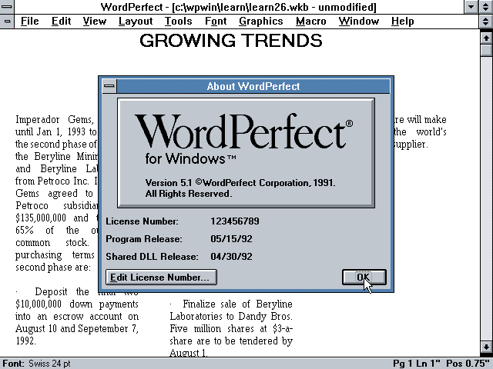
Émulation
Notes:
I won't talk much about emulation because frankly, it's not an area I know much about but in digital preservation, emulation involves using software that mimics an obsolete computing environment as a means to engage with files that are native to that environment. So going back to our example of the old word processing files from the 90s, you could use an emulator to run the software that the files were created on, and be able to interact with that content.
I would say that there's been a lot of interest in emulation in recent years the digipres community but it's for now anyway less common than migration and normalization

Slide 17
Infrastructure de préservation numérique
Notes:
I've shown you a handful of methods and tools used to do digital preservation on a small scale, but if you're looking to scale up these practices, it's not really practical to do all of these manually. So, there are a number of digital preservation systems out there that integrate these tools into a single workflow, that can be automated to a large extent. A lot of institutions actively engaged in digital preservation use these systems.

Slide 18

Infrastructure de préservation numérique
Archivematica est un logiciel gratuit et ouvert pour la préservation numérique. Il est conçu pour garantir un accès pérenne et conforme aux normes en vigueur à des collections de biens numériques.
Le logiciel rend disponible une gamme de services pour le traitement de biens numériques à des fins de préservation.
Notes:
I've shown you a handful of methods and tools used to do digital preservation on a small scale, but if you're looking to scale up these practices, it's not really practical to do all of these manually. So, there are a number of digital preservation systems out there that integrate these tools into a single workflow, that can be automated to a large extent. A lot of institutions actively engaged in digital preservation use these systems.
I'll be doing a mini demo of one of these systems, AM: This is what we're using at concordia for our digipres workflows
It's been widely adopted in the canadian cultural heritage community, as well as in the states and abroad
They essentially integrate a bunch of the opensource tools into one interface, to do a lot of the tasks that I just talked about

Slide 19
Démonstration de Archivematica
https://sandbox.archivematica.org/administration/accounts/login/
Nom d’utilisateur ou d’utilisatrice : demo@example.com
Mot de passe : demodemo
Notes:
https://sandbox.archivematica.org/administration/accounts/login/
demo@example.com
password: demodemo

Slide 20
Ressources introductives à la préservation numérique
DPC Digital Preservation Handbook:
Introduction accessible à la préservation numérique
DPC Novice to Know-how training:
Formation en ligne gratuite sur des sujets liés à la préservation numérique

Slide 21
sarah.lake@concordia.ca

